Slide 1


Apache Kylin on HBase
Extreme OLAP Engine for Big Data
Shaofeng Shi | 史少锋
Apache Kylin Committer & PMC
August 17,2018

Slide 2
Content
01
What is Apache Kylin
Apache Kylin introduction, architecture and relationship with others
02
Why Apache HBase
Key factors that Kylin selects HBase as the storage engine
How to use HBase in OLAP
03
How Kylin works on HBase
04
Use Cases
Apache Kylin typical use cases

Slide 3
What is Apache Kylin
01

Slide 4

What is Apache Kylin
OLAP engine for Big Data
Apache Kylin is an extreme fast OLAP engine for big data.
Interactive
Reporting
Dashboard
BI and Visualization
Apache Kylin
Add the title
OLAP engine
Hive/Kafka
MR/Spark
HBase
Hadoop Platform
Add the title
Notes:
Kylin connects your business application with big data platform via SQL.

Slide 5
What is Apache Kylin
Key characters
Real Interactive
Ease of Use
Trillion rows data, 99% queries < 1.3 seconds, from Meituan.com
1
No programing; User-friendly Web GUI;
ANSI-SQL
2
MOLAP Cube
User can define a data model and pre-build in Kylin with more than 10+ billions of raw data records
SQL on Hadoop, supports most ANSI SQL query functions
3
4
Seamless BI Integration
Hadoop Native
JDBC/ODBC/REST API; Supports Tableau, MSTR, Qlik Sense, Power BI, Excel and others
Compute and store data with MapReduce/Spark/HBase, fully scalable architecture;

Slide 6





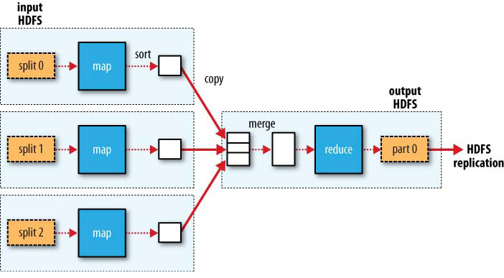
Apache Kylin Architecture
Native on Hadoop, Horizontal Scalable
BI Tools, Web App…
ANSI SQL
Kylin
OLAP Cube

Slide 7
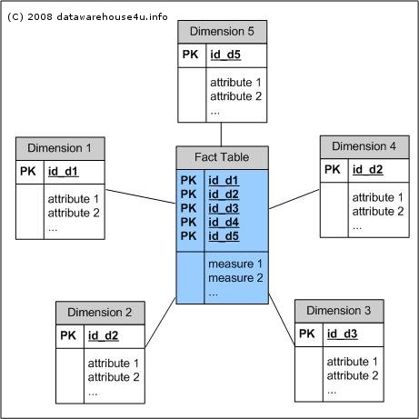
Why Kylin is fast
Pre-calculation + Random access
Define a data model: dimensions +measures
Pre-join and aggregate source data into OLAP cube
0-D(apex) cuboid
time
item
location
supplier
1-D cuboids
time, item
time, location
Time, supplier
item, location
item, supplier
location, supplier
2-D cuboids
time, location, supplier
item, location, supplier
3-D cuboids
time, item, location
time, item, supplier
time, item, location, supplier
4-D(base) cuboid

Slide 8

Why Kylin is fast
Pre-calculation + Random access
Join and aggregate data to Cube in offline
No join at query time
Convert SQL query to Cube visiting
Filter with index and do online calculation within memory
Sort
Sort
Aggr
Online calculation
Filter
Filter
Offline build
Cuboid
Join
Aggregated Data
O(1)
Tables

Slide 9
Why Apache HBase
02

Slide 10






Criteria of the Storage engine for Kylin
Hadoop Native
Low Latency
High Capacity
Wide Adoption
Easy to use API
Active User Community

Slide 11
Only HBase Can
Hadoop Native
Low Latency
HBase is built on Hadoop technologies; It Integrates well with HDFS, MapReduce and other components.
Block cache and Bloom Filters for real-time queries.
High Capacity
Wide Adoption
Supports very large data volume, TB to PB data in one table.
Most Hadoop users are running HBase;
Easy to use API
Active User Community
HBase has many active users, which provides many good articles and best practices.

Slide 12

HBase in Kylin
HBase acts four roles in Kylin
Massive Storage for Cube
Kylin persists OLAP Cube in HBase, for low latency access.
Metadata
MPP for online calculation
Kylin pushes down calculations to HBase region servers for parallel computing.
Scan & pushdown
HBase Master
Meta Store
…
Coprocessor
Coprocessor
Kylin uses HBase to persist its metadata.
HBase
Region Server
HBase
Region Server
Cache
Kylin caches big lookup table in HBase.

Slide 13
How to use HBase in OLAP
03

Slide 14
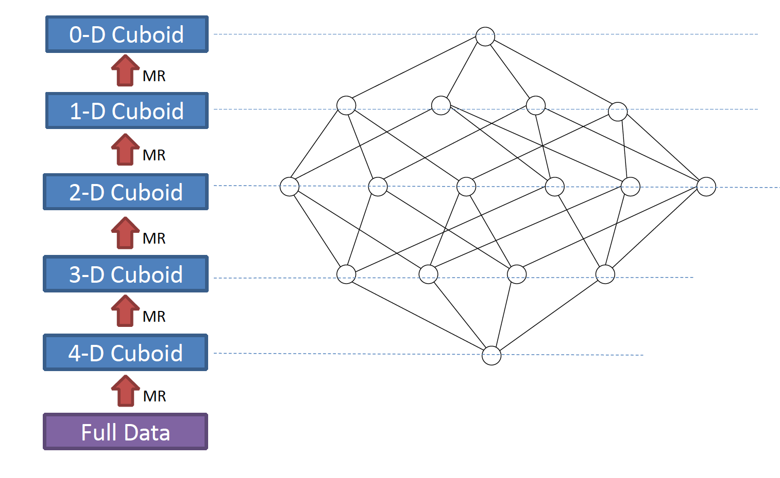
How Cube be Built
Cube building process
Kylin uses MR or Spark to aggregate source data into Cube;
The typical algorithm is by-layer cubing;
Calculate N-Dimension cuboid first, and then calculate N-1.

Slide 15
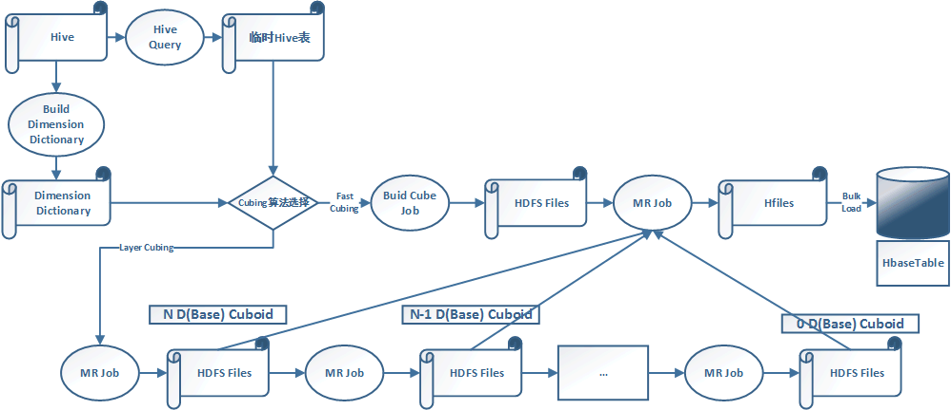
How Cube be Built
The whole Cube building process

Slide 16
Cube in HBase
Cube Structure
Cube is partitioned into multiple segments by time range
Each segment is a HBase Table
Table is pre-split into multiple regions
Cube is converted into HFile in batch job, and then bulk load to HBase
Cube
Seg 1
Seg 2
…
Seg N
Table 1
Table N
Rowkey | Value
Rowkey | Value

Slide 17
HBase Table Format
Rowkey + Value
Dimension values are encoded to bytes (via dictionary or others)
Measures are serialized into bytes
HBase Rowkey format: Shard ID (2 bytes) + Cuboid ID (8 bytes) + Dimensions
HBase Value: measures serialized bytes
Table is split into regions by Shard ID
User can group measures into 1 or multiple column families
Shard ID | Cuboid ID （long) | Dim 1 | Dim 2 | … | Dim N
Measure 1 | … | Measure N
2 bytes
8 bytes
Rowkey
Value

Slide 18
How Cube be Persisted in HBase
Example: a Tiny Cube
2 dimensions and 1 measure; total 4 cuboids: 00,01,10,11
Please note the Shard ID is not appeared here
Notes:
“+”is used to separate Cuboid ID and dimensions; In real case there is no separator.

Slide 19
How Cube be Queried
Kylin parses SQL to get the dimension and measures;
Identify the Model and Cube;
Identify the Cuboid to scan;
Identify the Cube segments;
Leverage filter condition to narrow down scan range;
Send aggregation logic to HBase coprocessor, do storage-side filtering and aggregation;
On each HBase RS returned, de-code and do final processing in Calcite
Dimension: city, year
Cuboid ID: 00000011
Filter: year=1993 (encoded value: 0)
Scan start: 00000011|0
Scan end: 00000011|1
select city , sum(price) from table where year= 1993 group by year

Slide 20
Good and not-good of HBase for OLAP
HBase is a little complicated for OLAP scenario; HBase supports both massive write + read; while OLAP is read-only.
Native on Hadoop.
Great performance (when search pattern matches row key sequence)
High concurrency
Not a columnar storage
No secondary index
Failover is slow
Has downtime for upgrade (update coprocessor need to disable table first)
…

Slide 21
Use Cases
04

Slide 22
1000+ Global Users
Internet
eBay
Yahoo! Japan
Baidu 百度
Meituan 美团
NetEase 网易
Expedia
JD 京东
VIP 唯品会
360
TOUTIAO 头条
…
FSI
CCB 建设银行
CMB 招商银行
SPDB 浦发银行
CPIC 太平洋保险
CITIC BANK 中信银行
UnionPay 中国银联
HuaTai 华泰证券
GuoTaiJunAn 国泰君安证券
…
Telecom
China Mobile
China Telecom
China Unicom
AT & T
…
Manufacturing
SAIC 上汽集团
Huawei 华为
Lenovo 联想
OPPO
XiaoMi 小米
VIVO
MeiZu 魅族
…
Others
MachineZone
Glispa
Inovex
Adobe
iFLY TEK科大讯飞
…

Slide 23
Use Case – OLAP on Hadoop
Meituan: Top O2O company in China
Challenge
Slow performance with previous MySQL option Heavy development efforts with Hive solution
Huge resources for Hive job
Analysts can’t access directly for data on Hadoop
Solution
Apache Kylin as core OLAP on Hadoop solution
SQL interface for internal users
Active participate in open source Kylin community
973 Cubes, 8.9+ trillion rows, Cube size 971 TB
3,800,000 queries/day, TP90 < 1.2 second
(Data in 2018/08)
Supporting all Meituan business lines

Slide 24
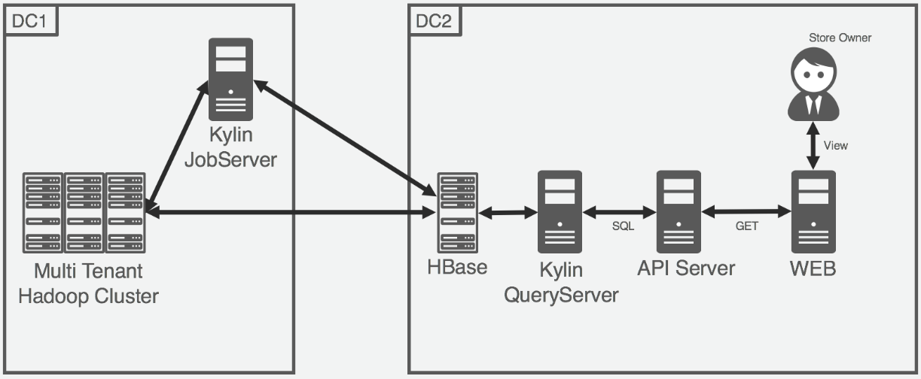
Use Case – Shopping Reporting
Yahoo! Japan: the most visited website in Japan
We provide a reporting system that show statistics for store owners.
e. g. impressions, clicks and sales.
Our reporting system used Impala as a backend database previously. It took a long time (about 60 sec) to show Web UI.
In order to lower the latency, we moved to Apache Kylin.
Average latency < 1sec for most cases
Thanks to low latency with Kylin, we become possible to focus on adding functions for users.

Slide 25


We are hiring

Slide 26
Thanks

Slide 27


















Add the title
Subtitle Text
More AIS ICONS please visit：
Add the title
www.iconfont.cn/plus/collections/detail?cid=2257
Modules do not limit the size, number, interval, can be adjusted according to need
Modules do not limit the size, number, interval, can be adjusted according to need
Modules do not limit the size, number, interval, can be adjusted according to need

